Slide 1
Cyber Threat Intelligence for Ransomware Detection in Bitcoin Transactions
Presented by
Vasanthakumar (960521104072)
Lido Shanfear (960521104036)
Muthu Veerappan (960521104041)
Krishnamoorthi (960521104034)

Slide 2
Abstract
This project proposes a machine learning framework to detect ransomware-linked Bitcoin addresses using the BitcoinHeist dataset. An XGBoost model, enhanced with SMOTE for class balance, is trained for accurate classification. Unlike prior works, our system integrates real-time transaction data and a Streamlit dashboard for live detection and visualization, offering a practical approach to ransomware threat monitoring on the Bitcoin network.

Slide 3
Introduction
Ransomware attacks have grown rapidly, with attackers often demanding payments in cryptocurrencies like Bitcoin due to their anonymity. These attacks can lock critical systems and data, causing severe financial and operational damage. This project aims to detect ransomware-related Bitcoin transactions using machine learning techniques. By analyzing transaction patterns and behaviors, we can identify suspicious addresses and take preventive measures early.

Slide 4
Existing System
Static offline analysis only
Uses Random Forest with LIME
No real-time monitoring or API integration

Slide 5
Proposed System
Uses XGBoost with SMOTE for class balance
Real-time data fetched via APIs
Detects high-risk addresses live
Interactive Streamlit dashboard

Slide 6
Literature Survey
Transparent Ransomware Detection (IEEE base paper)
Chen et al. (2020)Used the BitcoinHeist dataset to train ML models like Random Forest and XGBoost. Found XGBoost to be effective in distinguishing malicious wallets
ML + Blockchain for real-time detection

Slide 7
System Architecture
Input: Bitcoin address
Processing:
- Transaction fetch
- Feature extraction
- Prediction
Output: Risk classification + visualization

Slide 8
Modules Overview
Data Collection
Preprocessing
Model Training
Live Detection
Visualization

Slide 9
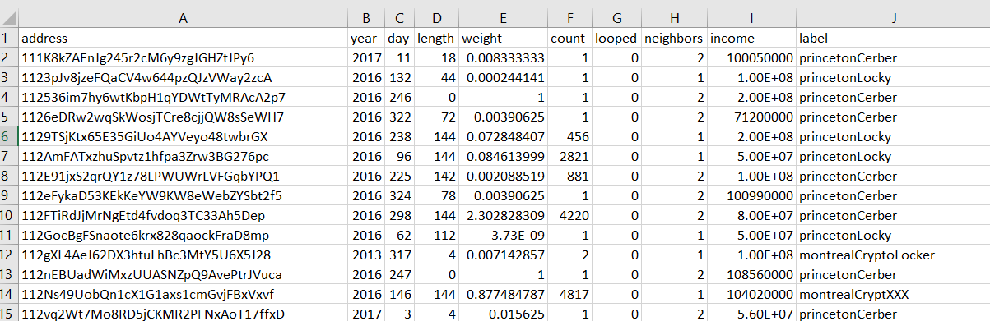
Module 1 – Data Collection
BitcoinHeist.csv for labeled data
Live data via Blockchain Developer APIs
https://api.blockchaindeveloperapi.com

Slide 10
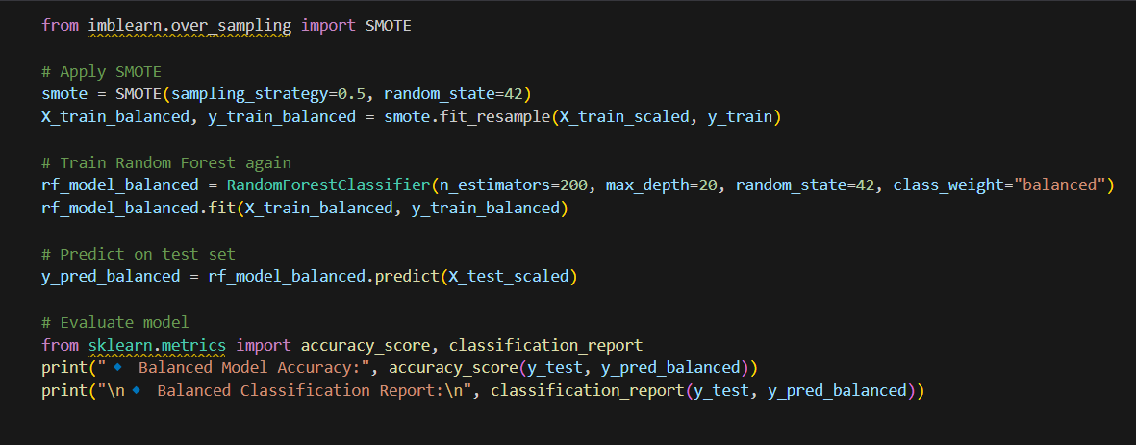
Module 2 – Preprocessing
Data cleaning
Feature engineering
SMOTE for balancing

Slide 11
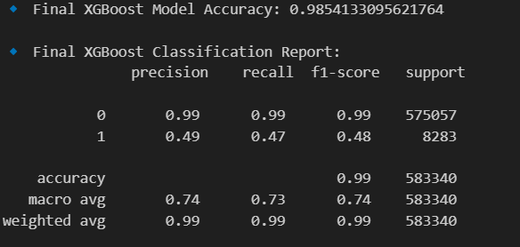
Module 3 – Model Training
XGBoost Classifier
Input: 18 features
Accuracy: 97.2%
Precision: 95.8%

Slide 12
Module 4 – Live Detection
Input: Bitcoin address
Real-time API data
Classifies transactions
Flags high-risk ones

Slide 13
Module 5 – Streamlit Dashboard
Pie chart: Safe vs Suspicious
Bar chart: Top 10 gas users
Table: All flagged transactions
Alerts for high-risk activity

Slide 14
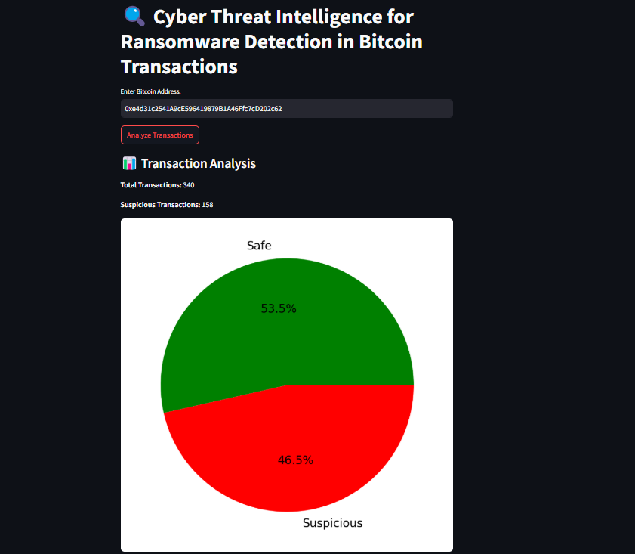
Streamlit interface

Slide 15
Results & Conclusion
Accurate ransomware detection
Combined static + live data
SMOTE improved model
Future work: SHAP, ETH, tracing

Slide 16
References
IEEE Base Paper
BitcoinHeist (Kaggle)
scikit-learn, XGBoost
Blockchain APIs
Streamlit

